Slide 1
Neural networks and SVMs
Notes:
Let’s start this class in a way you might not expect a CS class to start: by thinking about a classic puzzle.

Slide 2
Announcements
Assignment 4 due Thursday
Assignment 5 due Tuesday 12/13
Final exam Monday 12/12

Slide 3
2000’s: Return to the simple
Return to simpler techniques, like linear classifiers
But in high dimensions
Simpler learning algorithms, easier to justify theoretically
Learn classifiers on manually-created features
E.g. not images themselves, but statistical features like color histograms, edge distributions, etc.

Slide 4
Linear classifiers
Plane equation: 0 = x₁θ₁ + x₂θ₂ + … + x_{n}θ_{n} + b
If x₁θ₁ + x₂θ₂ + … + x_{n}θ_{n} + b > 0, positive example
If x₁θ₁ + x₂θ₂ + … + x_{n}θ_{n} + b < 0, negative example
Separating plane

Slide 5
Linear classifiers
Plane equation: x₁θ₁ + x₂θ₂ + … + x_{n}θ_{n} + b = 0
C = Sign(x₁θ₁ + x₂θ₂ + … + x_{n}θ_{n} + b)
If C=1, positive example, if C= -1, negative example
Separating plane
(θ₁,θ₂)
(-bθ₁, -bθ₂)

Slide 6
Linear classifiers
Plane equation: 0 = x₁θ₁ + x₂θ₂ + … + x_{n}θ_{n} + b
If x₁θ₁ + x₂θ₂ + … + x_{n}θ_{n} + b > 0, positive example
If x₁θ₁ + x₂θ₂ + … + x_{n}θ_{n} + b < 0, negative example
Separating plane
(θ₁,θ₂)

Slide 7
Linear classifiers
Let w = (θ₁,θ₂,…,θ_{n}) (vector notation)
Special case: ||w|| = 1
b is the offset from the origin
The hypothesis space is the set of all (w,b), ||w||=1
Separating plane
w
b

Slide 8
Linear classifiers
Find linear function (hyperplane) to separate positive and negative examples
For linearly separable problems, perceptrons give a hyperplane separating the classes. But:
which hyperplane is best?
what about non-separable problems?

Slide 9
Linear classifiers
Plane equation: 0 = w•x + b
If w•x + b > 0, positive
If w•x + b < 0, negative

Slide 10
Support vector machines
Find hyperplane that maximizes the margin between the positive and negative examples
For support vectors,
Distance between point and hyperplane:
Therefore, the margin is 2 / ||w||
Support vectors
Margin

Slide 11
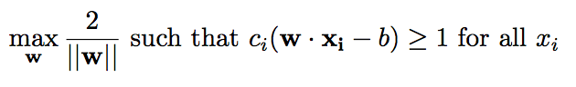
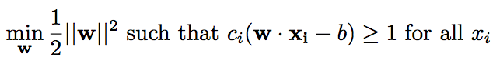
Learning an SVM
Find w and b, given a set of training vectors x₁…x_{N} and corresponding labels c₁…c_{N}, where each c_{i} is +1 or -1
Pose as a constrained optimization problem
Maximize the margin, subject to
constraint that the predicted labels
are correct, i.e.:
For mathematical convenience, people usually
instead minimize:
Margin =
2/||w||

Slide 12
Key Insights
The optimal classification boundary is defined by just a few (d+1) points: support vectors
Margin

Slide 13
Lagrange…
So…

Slide 14
Lagrange…
So…
Setting to 0…

Slide 15
Lagrange…
So…

Slide 16
Lagrange…
So…
Setting to 0…

Slide 17
So…
Dependence only on the dot product!
Eq (18.13) in the book

Slide 18
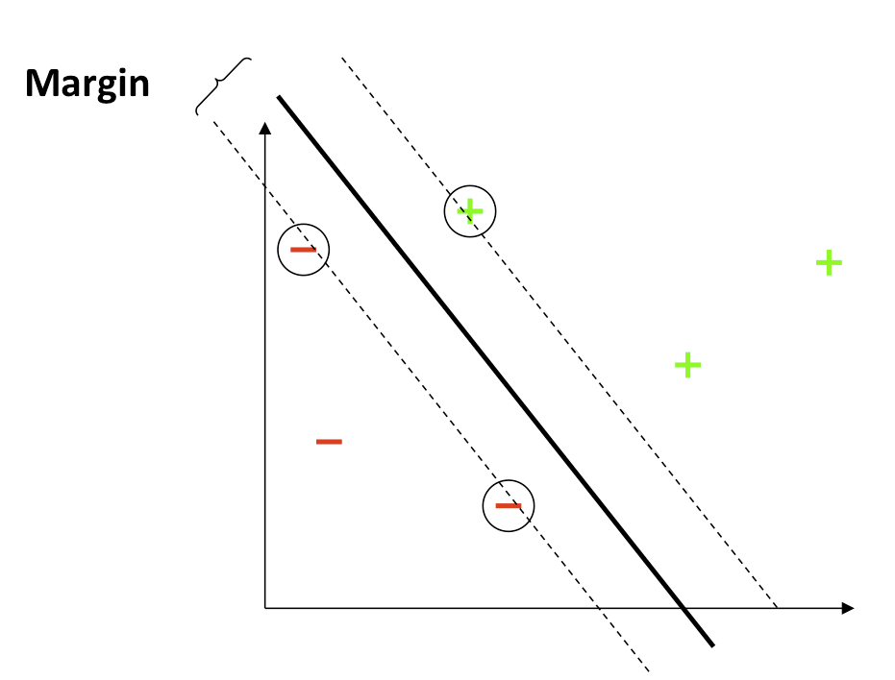
Using math...
Can find an optimal classification boundary
Then to classify new vector x:
If + b > 0, then positive
If + b < 0, then negative
Only a few alphas are
non-zero, so classification can
be performed efficiently

Slide 19
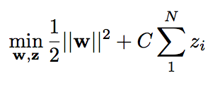
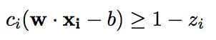
What if space is almost linearly separable?
It may not be possible to solve this optimization, due to mislabeled or outlying training exemplars
Use a “soft margin”
Introduce “slack variables” z_{i} that
measure misclassification error,
and minimize those
such that
Margin

Slide 20
What if space is not linearly separable?
Higher dimensions! And transformations! And robustness!
x₂
x₁

Slide 21
What if space is not linearly separable?
Higher dimensions! And transformations! And robustness!
Choose f₁=x₁², f₂=x₂², f₃=√2 x₁x₂
x₂
f₃
f₂
f₁
x₁

Slide 22
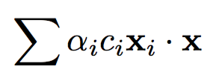
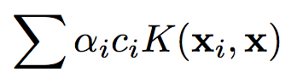
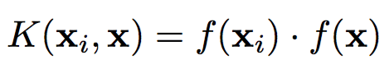
The kernel trick
Replace + b with + b
Notice we can’t necessarily precompute the decision boundary anymore; but since alphas are sparse, classification can still be efficient
Kernels of the form , where f() is a feature embedding function, work out particularly nicely
Kernel function

Slide 23
Kernel Functions
Can implicitly compute a feature mapping to a high dimensional space, without having to construct the features! (all you need is the dot product)
Example: K(a,b) = (a•b)²
(a₁b₁ + a₂b₂)² = a₁²b₁² + 2a₁b₁a₂b₂ + a₂²b₂² = [a₁² , a₂² , √2a₁a₂]•[b₁² , b₂² , √2b₁b₂]

Slide 24
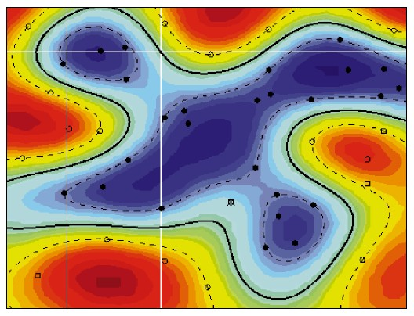
Types of Kernel
Polynomial K(a,b) = (a^{T}b+1)^{d}
Gaussian K(a,b) = exp(-||a-b||²/s²)
Sigmoid, etc…
Decision boundaries in feature space may be highly curved in original space!

Slide 25
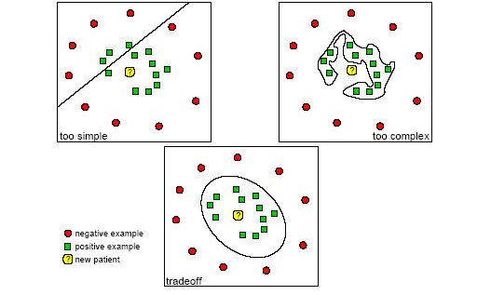
Overfitting / underfitting

Slide 26
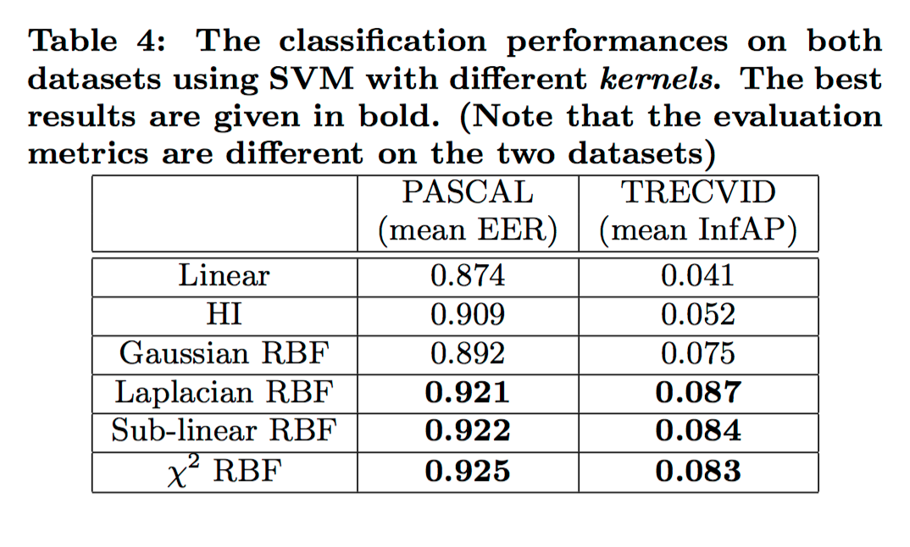
Which is the best kernel?
Linear is very fast. Others can be quite slow, both in learning and classification, but usually give better results. Best choice depends on application.
Jiang 2007

Slide 27
Decision rule
Recall:
If w•x + b > 0, positive
If w•x + b < 0, negative
But since
If + b > 0, then positive
If + b < 0, then negative
If x_{j} is NOT a SV then α_{j} = 0

Slide 28
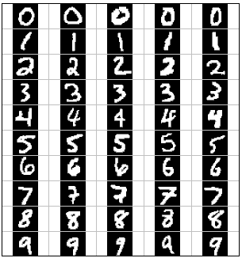
Comments
SVMs often have very good performance
E.g., digit classification, face recognition, etc
Still need parameter tweaking
Kernel type
Kernel parameters
Regularization weight
Fast optimization for medium datasets (~100k)
Off-the-shelf libraries
SVM^{light}

Slide 29
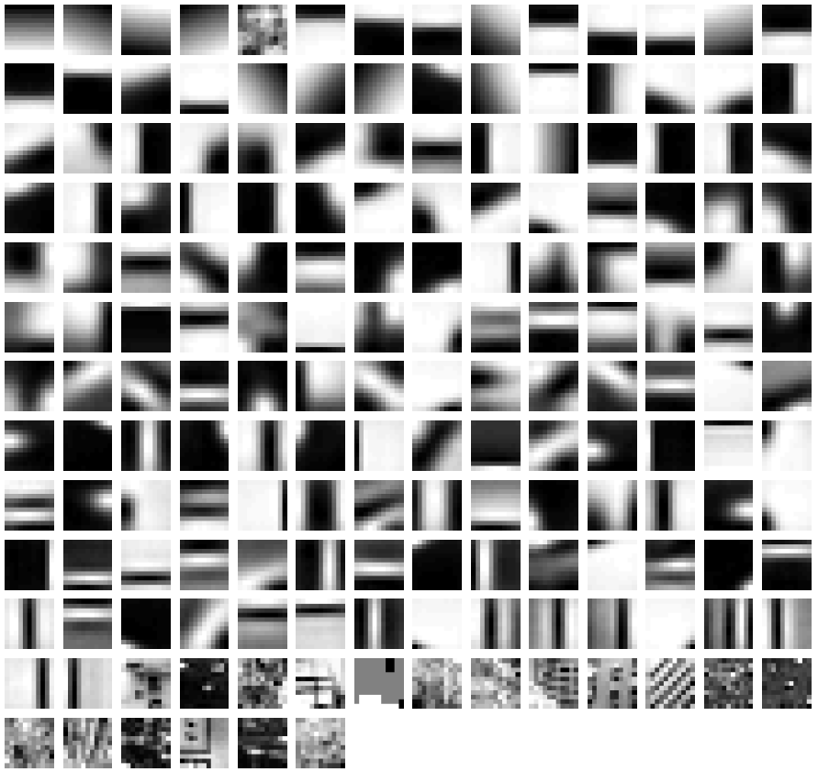
Example visual vocabulary
Fei-Fei et al. 2005

Slide 30
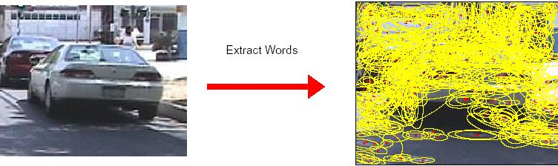
3. Image representation
frequency
…..
codewords

Slide 31
4. Learning a classifier
SVMs are de facto standard technique
RBF kernel usually works slightly (2-3%) better, but at significantly higher computational cost
Why such a modest improvement?

Slide 32
Secret of SVM popularity
At their core, SVMs are simple linear classifiers, but:
Soft-margin learning allows for outliers – not “brittle” like perceptron learning
Well-principled, easy to understand learning – less likely to fall into local minima
Many applications have high dimensional feature spaces with redundancy – linear classification works okay
Fast – classification is just a dot product, basic learning also fast (but gets complicated with kernels, slack variables, huge datasets, high dimensionality)
Kernel trick – allows trade-off between strength of model and danger of overfitting

Slide 33
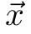
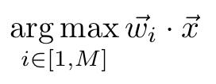
Multiclass SVM
Classify feature vector into one of M classes,
How do we learn the weight vectors?
Option 1: Train M SVMs, each one trained with a single class as positive exemplars, and all other classes as negative exemplars (“1 vs all”)
Option 2: Learn the weights all together in a single (harder) optimization problem (“multiclass SVM”)

Slide 34
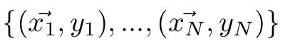
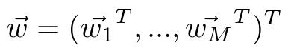
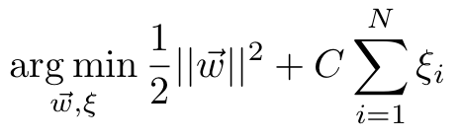
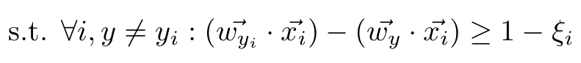
Multiclass SVM
Classify feature vector into one of M classes,
In learning, given set of exemplars and true class labels
, find ,
Can be solved efficiently using a cutting plane algorithm; e.g. [Tsochantaridis05]

Slide 35
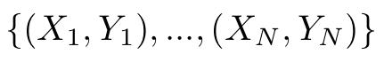
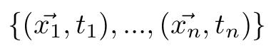
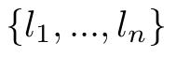
Structured SVMs
Learn e.g. parameters of HMM using a structured SVM, given set of exemplars
each X_{i} is a set of photo-timestamp pairs, ,
each Y_{i} is a sequence of true class (landmark) labels,
Solved using a cutting plane algorithm that considers the most violated constraint in each iteration; we use svm_struct [Joachims09]
Set of all possible state
labelings of exemplar X_{i}
Feature map function
Loss function
(# of mislabeled nodes)

Slide 36
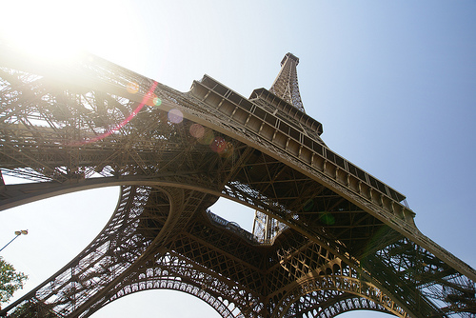
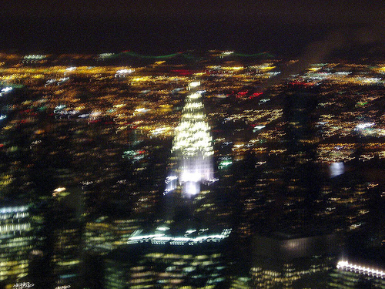
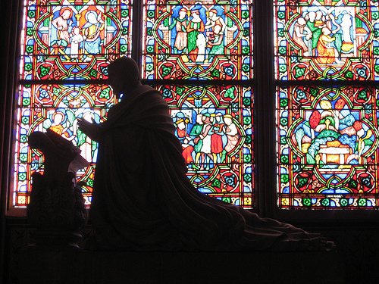
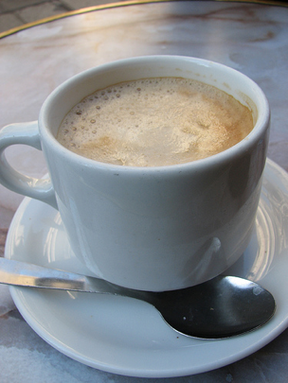
Visual geolocation: where was the photo taken?

Slide 37
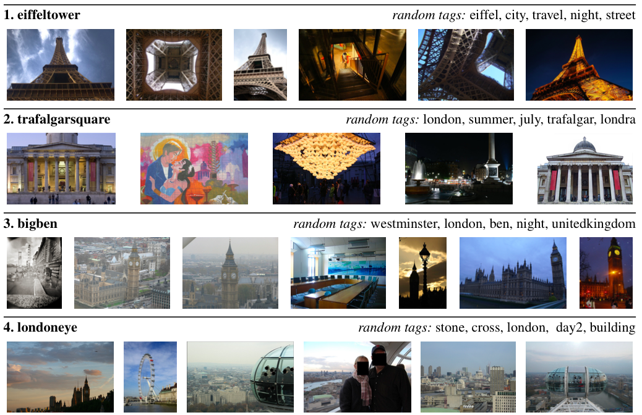

Slide 38
Landmark classification
Our task: given a photo known to be taken at one of n landmarks, identify the correct landmark
Define classes based on data-driven “hotspots” of photo activity
For training, use ~100 million geo-tagged Flickr photos
Geo-tags give us (noisy) ground truth labels
For testing, use separate set of millions of Flickr photos
Approach based on “bag of visual words” models
Y. Li, D. Crandall, D. Huttenlocher. “Landmark recognition in large-scale image collections,” ICCV 2009.

Slide 39
Vector space model
Represent a document as a histogram over word frequency
When in the Course of human events, it becomes necessary for one people to dissolve the political bands which have connected them with another, and to assume among the powers of the earth, the separate and equal station to which the Laws of Nature and of Nature's God entitle them, a decent respect to the…
frequency
...
abdicated
abolish
absolute
absolved
accommodation
acquiesce
acts
administration
affected
against
ages
Encode mathematically as a vector:
(1,4,3,1,0,1,3,2,1,1,2 …

Slide 40
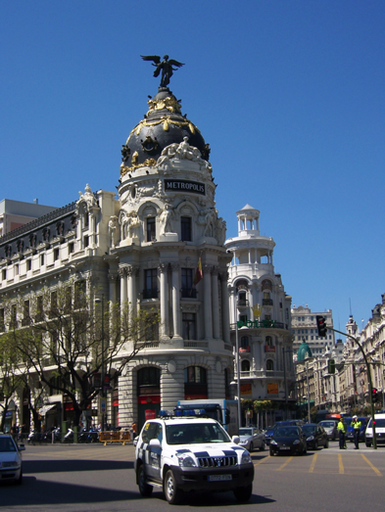
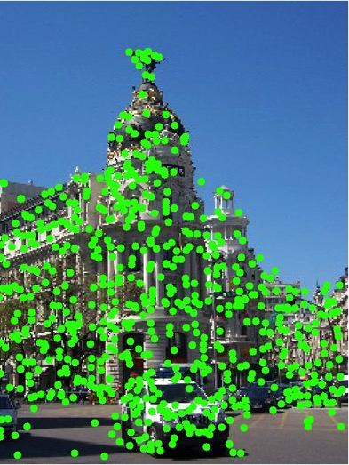
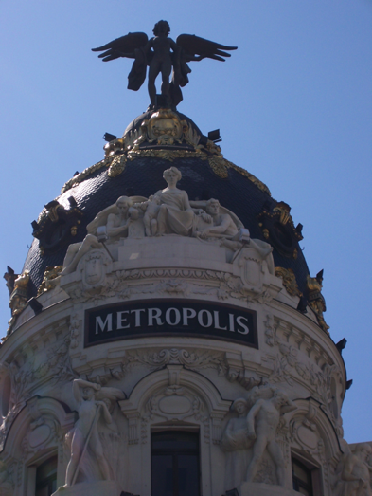
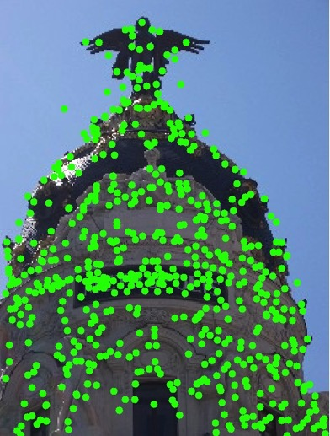
Find “interest points”

Slide 41
Build a "visual vocabulary"
Fei-Fei et al. 2005

Slide 42
Map features to words
Given a feature in a new image, assign it to the closest visual word in the clustered “vocabulary”
128d SIFT feature
from image patch
2
1
X
Assigned to
word #1
3
Adapted from slide by J. Sivic

Slide 43
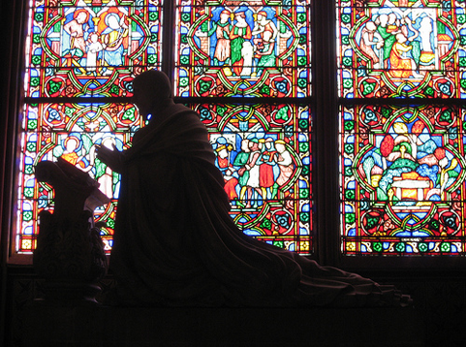
Compute visual word histogram for each image
frequency
…..
codewords

Slide 44
Apply “shallow” machine learning
Given feature vectors from many labeled images, learn a model of a landmark
E.g. using a Support Vector Machine (SVM)

Slide 45
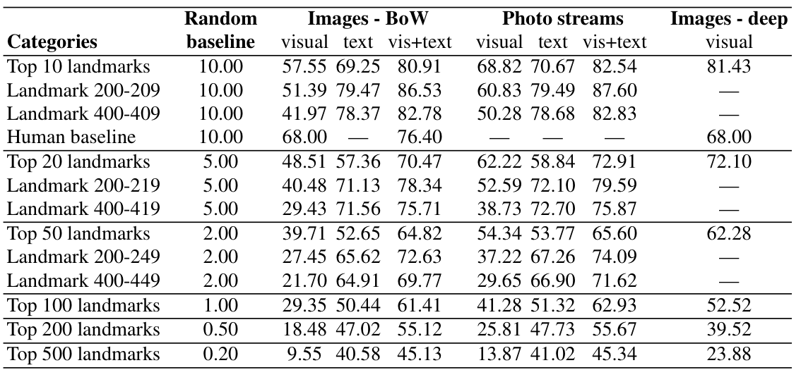
Landmark classification results
Y. Li, D. Crandall, D. Huttenlocher. “Landmark recognition in large-scale image collections,” ICCV 2009.

